Slide 1
DATA ANALYST NANODEGREE
Session 1
Conducted by: Hamza
Notes:
https://udacity.zoom.us/j/7991233356
‹#›

Slide 2
SLACK / SUPPORT / REPOS
https://join.slack.com/t/egfwd-t3-october-22/shared_invite/zt-1hk7owwgy-6~9jmz47ud9xTj_O3DS4qg
fwd-support@udacity.com
https://github.com/santarabantoosoo/Data-Analysis-NanoDegree-2.0
Notes:
‹#›

Slide 3




Slide 4



Slide 5



Slide 6
AGENDA
Orientation
Resources
Data analysis Vs data science Vs ML Vs statistics
SQL Project walkthrough
Breakout room

Slide 7
POINTS TO CONSIDER
Connect session same time same day
Revoking
Better come prepared
Plagiarism
Notes:
‹#›

Slide 8






GETTING STARTED
https://www.udacity.com/bertelsmann-tech-scholarships
Links?
Notes:
Ask questions
Answer questions
Post resources
Share ideas of projects and ask for collaborators
Share life hacks
Share job opportunities
‹#›

Slide 9
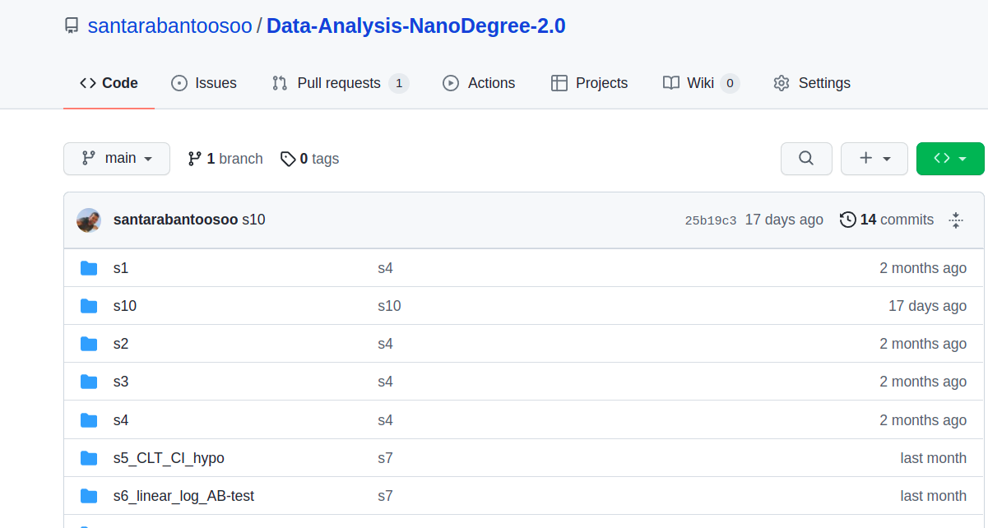
GITHUB DEMO
https://github.com/santarabantoosoo/Data-Analysis-NanoDegree-2.0

Slide 10
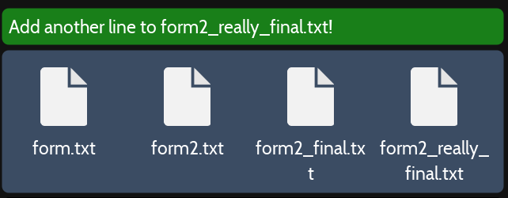

why git?
https://ohmygit.org/
Track projects
- Time machine (rescue)

Slide 11

whi git? (cont.)
get the best of both worlds

Slide 12
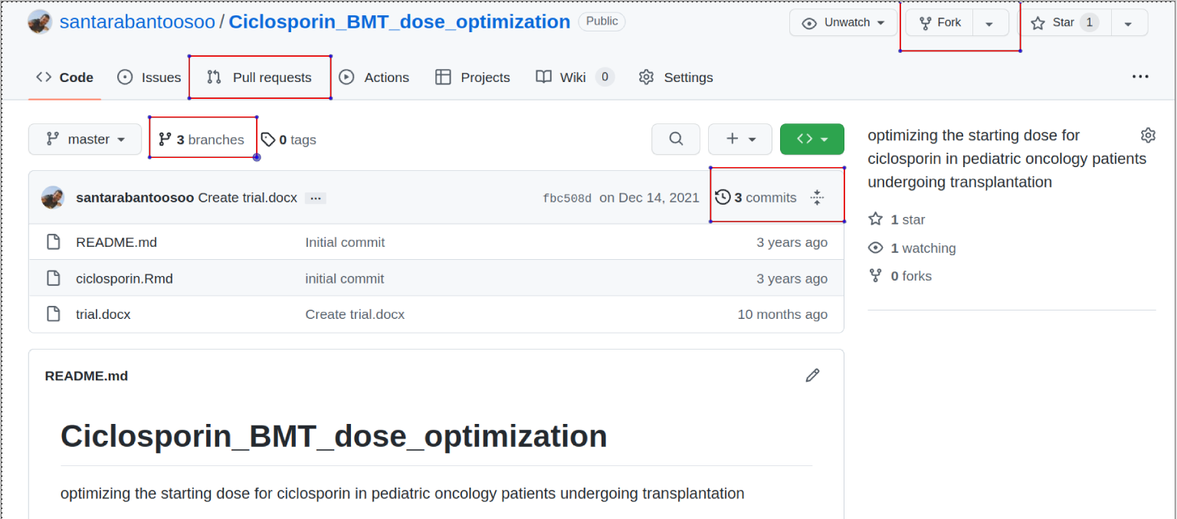
Multiple versions
Rescue
parallel universe
collaboration
Notes:
how to collaborate?
How to Use the Github Workflow - YouTube
https://www.youtube.com/watch?v=8UguQzmswC4
Since 2018
multiple versions

Slide 13
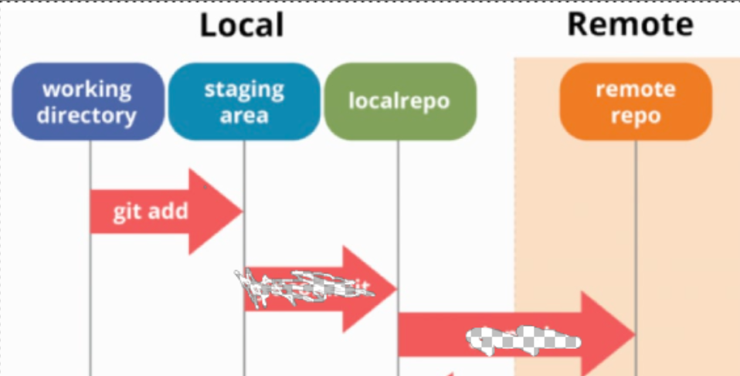
GIT FLOW

Slide 14
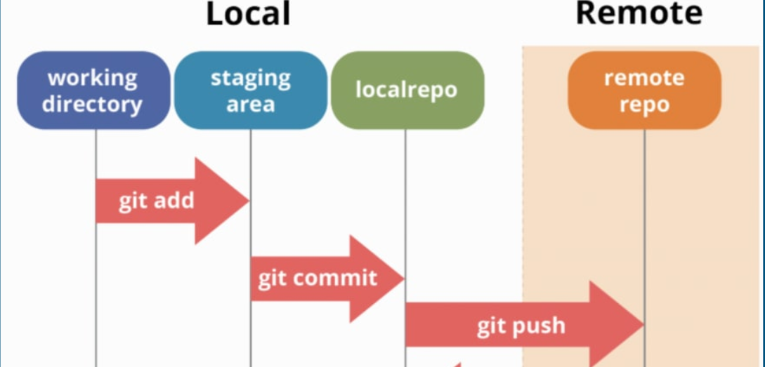
GIT FLOW

Slide 15

Github demo

Slide 16
BREAKOUT ROOMS
Leaders
Responsibilities:
Share screen
Reporting progress to me
troubleshooting
Benefits:
First to get access to datacamp
Higher chance for a udacity recommendation

Slide 17
Breakout rooms
current task:
https://docs.google.com/spreadsheets/d/1YyXFrFmaCCztJmKoCrVFI3RHMiBEC0ZqfdIa9y8UWc8/edit#gid=0
For github:
Create a repo and add at least one collaborator
git clone <repo>
git add <file>
git commit -m ‘msg’
git push
Notes:
git clone <repo>
git add <file>
git commit -m ‘msg’
git push

Slide 18


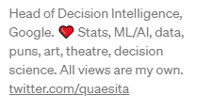

خد فكرة
Notes:
‹#›

Slide 19
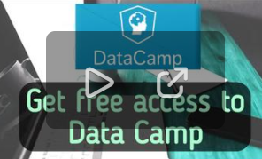
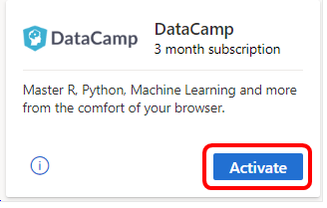
GITHUB STUDENT DEVELOPER PACK
https://docs.google.com/spreadsheets/d/1DW5lykfxM3KUgCQrSLFoOwmDfeaADPPOp3troBcYY6w/edit#gid=0
Notes:
‹#›

Slide 20

POP QUIZ
والجوائز ايه يا أستاذ ؟

Slide 21

COMPLETE
الخناقة كانت على 10 متر سيراميك ..

Slide 22
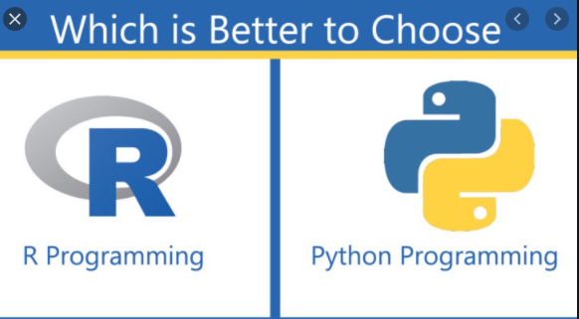

العركة

Slide 23
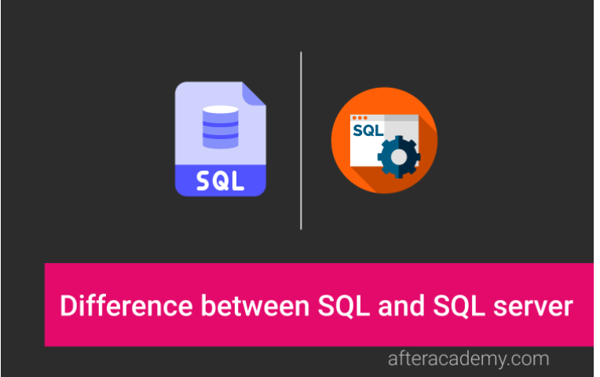
DIFFERENCE?
Notes:
SQL Server = MS SQL
It is to be noted that the queries can only be written using SQL, but we need some RDBMS(Relational Database Management Systems) like SQL Server, Oracle to execute those SQL commands and queries.
What is the difference between SQL and SQL server?
https://afteracademy.com/blog/what-is-the-difference-between-sql-and-sql-server
‹#›

Slide 24
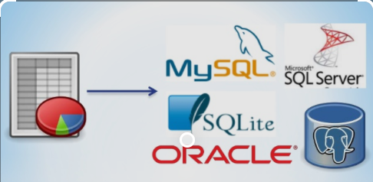
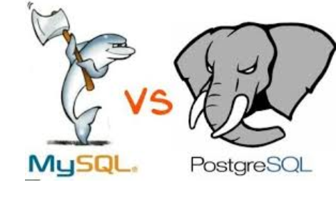
RELATIONAL DB MANAGEMENT SYSTEMS
Notes:
‹#›

Slide 25
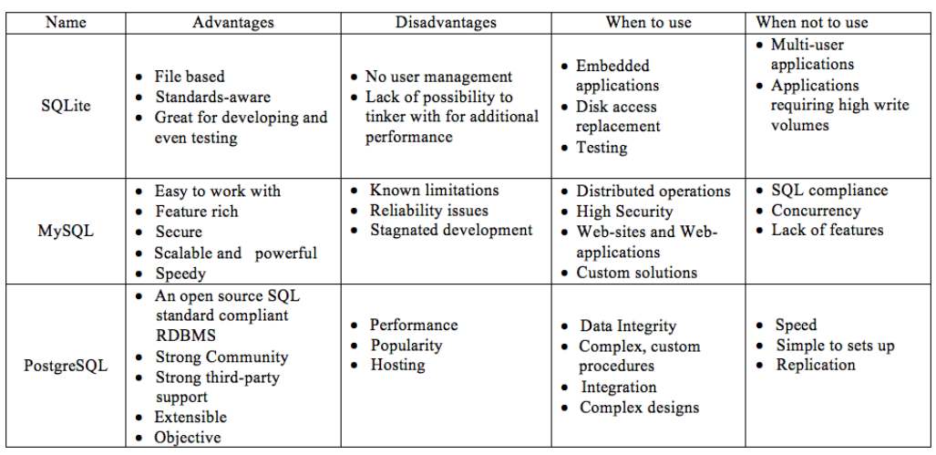
Notes:
SQLite vs MySQL vs PostgreSQL: A Comparison Of Relational Database Management Systems | by Yang Wang | Medium
https://medium.com/@yangforbig/sqlite-vs-mysql-vs-postgresql-a-comparison-of-relational-database-management-systems-afd5afd6566
SQLite vs MySQL vs PostgreSQL: A Comparison Of Relational Database Management Systems | DigitalOcean
https://www.digitalocean.com/community/tutorials/sqlite-vs-mysql-vs-postgresql-a-comparison-of-relational-database-management-systems
‹#›

Slide 26
العركة

Slide 27

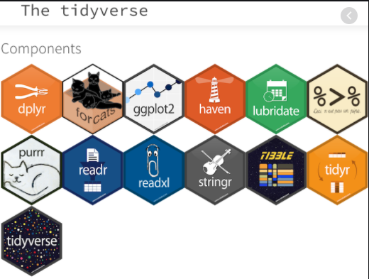


Slide 28
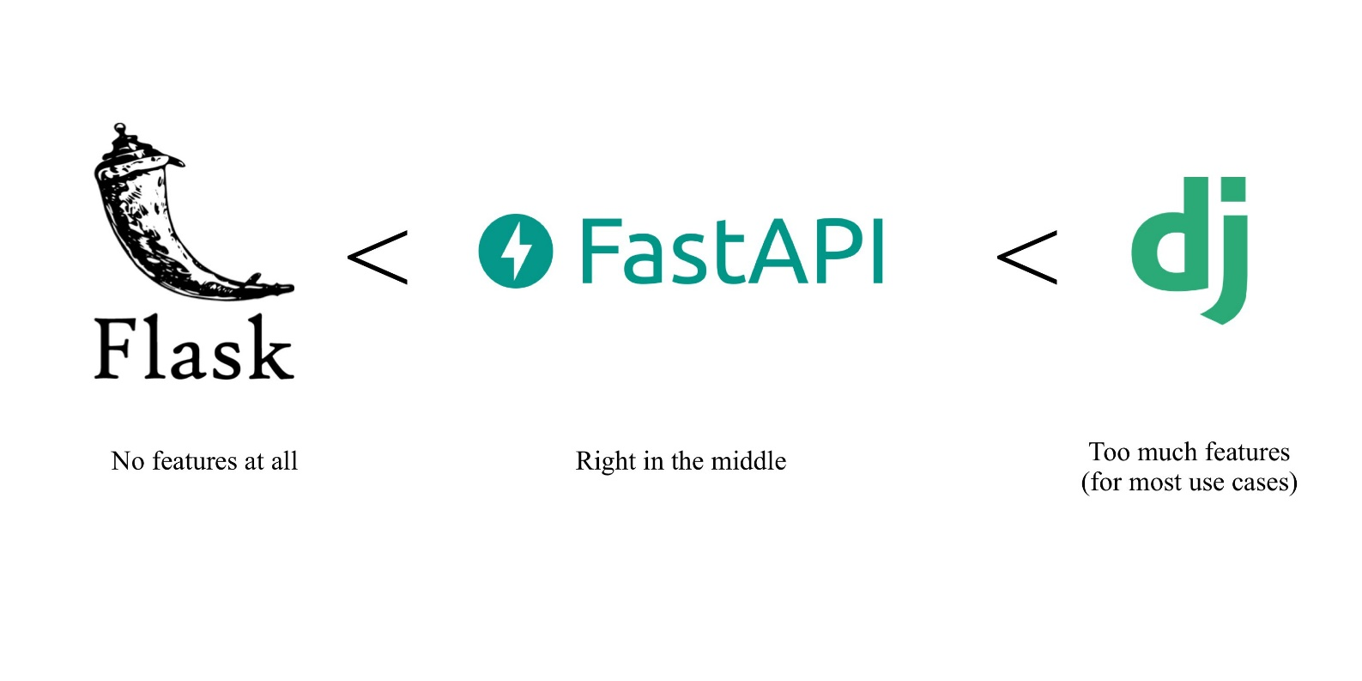
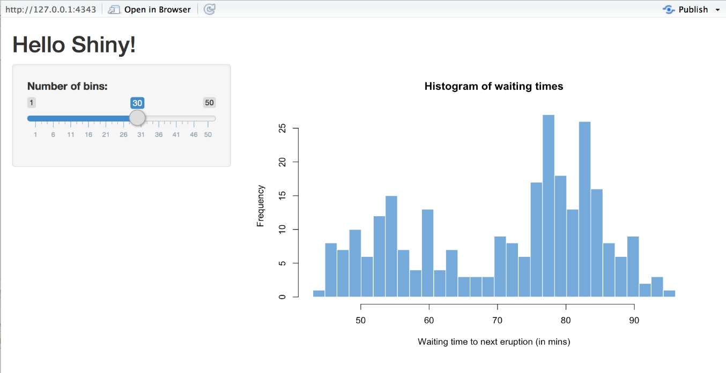


Slide 29



MACHINE LEARNING

Slide 30

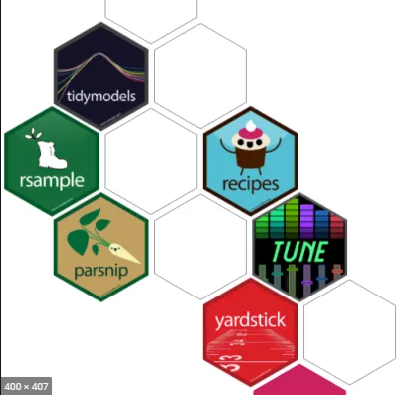

THINK AGAIN?

Slide 31



DEEP LEARNING
Notes:
‹#›

Slide 32

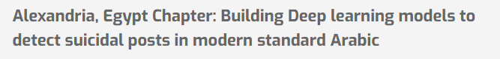
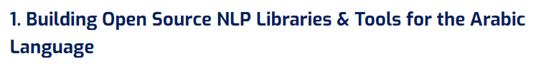
OMDENA
Notes:
Omdena Egypt Chapter - Omdena Chapters
https://omdena.com/omdena-chapter-page-egypt/
‹#›

Slide 33

GOOD OPPORUNITY
Translating English data science articles to Arabic using transformers models
Notes:
Omdena Egypt Chapter - Omdena Chapters
https://omdena.com/omdena-chapter-page-egypt/
‹#›

Slide 34

PYTHON ONLY? SQL ?? R??

Slide 35

THINK AGAIN

Slide 36

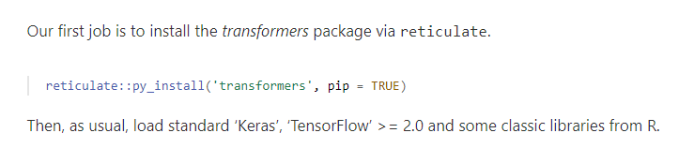
Notes:
RStudio AI Blog: State-of-the-art NLP models from R
https://blogs.rstudio.com/ai/posts/2020-07-30-state-of-the-art-nlp-models-from-r/
‹#›

Slide 37
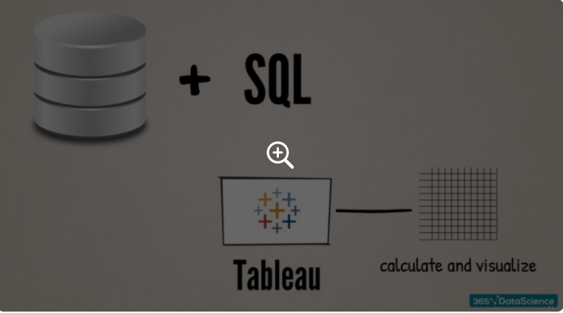
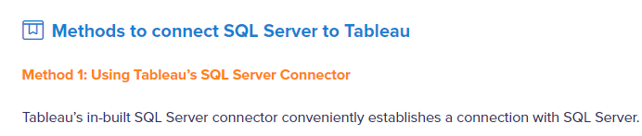
SQL + TABLEAU
Notes:
Integrating SQL and Tableau | 365 Data Science
https://365datascience.com/tutorials/sql-tutorials/integrating-sql-tableau/
‹#›

Slide 38

SQL to python

Slide 39
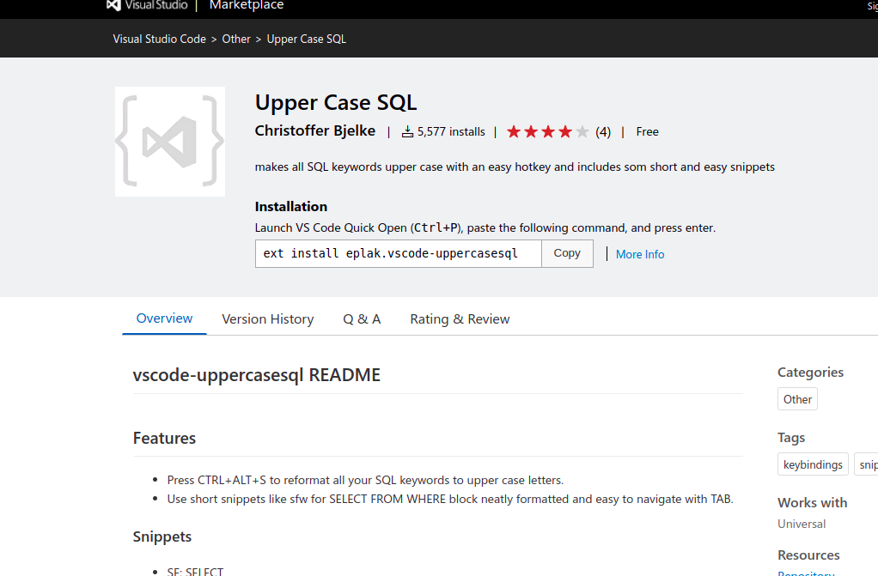
SQL extensions

Slide 40
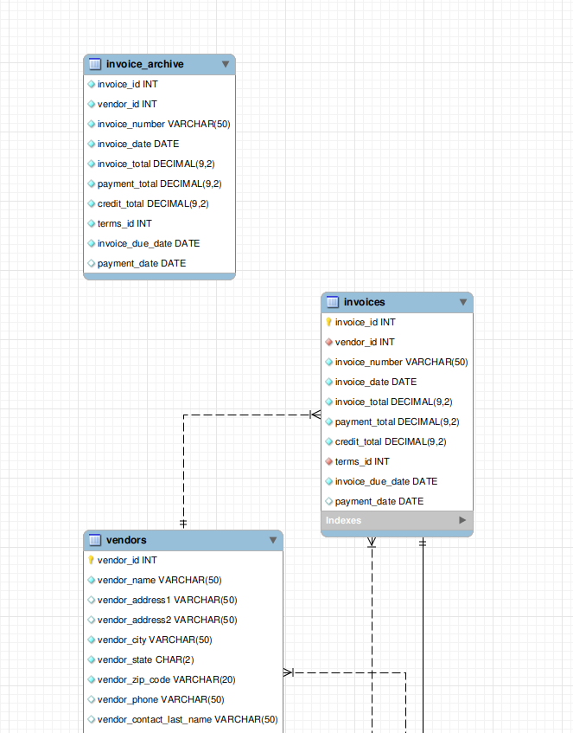
ER diagram
How to create using mysql workbench?
https://dataedo.com/kb/tools/mysql-workbench/create-database-diagram

Slide 41

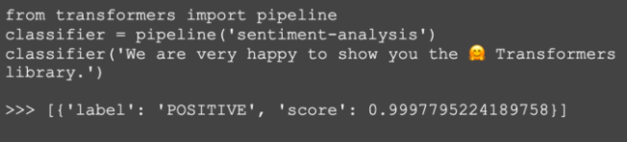
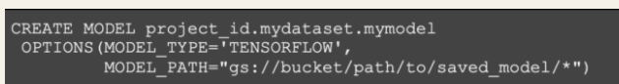
SQL + DEEP LEARNING

Slide 42
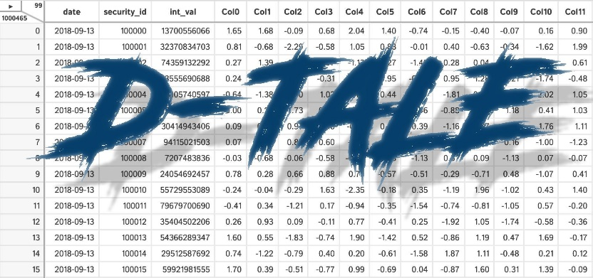

BOTTOM LINE?
1. Start
2. SEARCH – KEEP UPDATED!
Notes:
It doesn’t really matter. U can use any.
‹#›

Slide 43
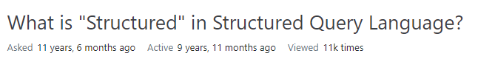
WHY CALLED STRUCTURED?
SEQUEL
Notes:
sql - What is "Structured" in Structured Query Language? - Stack Overflow
https://stackoverflow.com/questions/2938908/what-is-structured-in-structured-query-language
‹#›

Slide 44
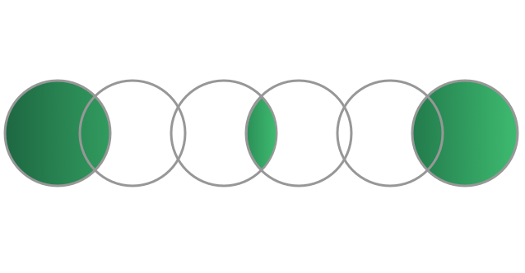
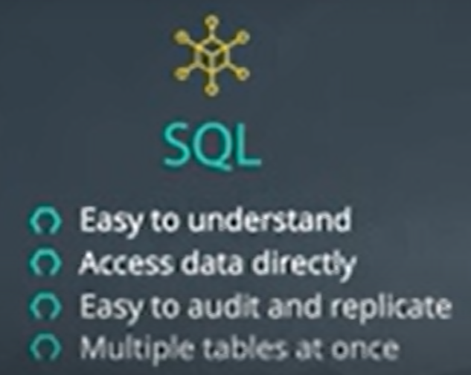
SQL
Why is SQL important? If we can use R/PYTHON?
Notes:
Huge tables – joined – without being loaded
If it can be replaced by other software?
SQL is easy to understand.
Traditional databases allow us to access data directly.
Traditional databases allow us to audit and replicate our data.
SQL is a great tool for analyzing multiple tables at once.
SQL allows you to analyze more complex questions than dashboard tools like Google Analytics.
SQL vs python
Access data directly I think
‹#›

Slide 45
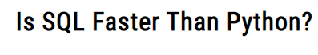

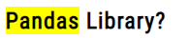
WHAT ABOUT SPEED?
Notes:
Is SQL Faster Than Python? The Answer May Surprise You – Data Science Nerd
https://datasciencenerd.com/is-sql-faster-than-python/
‹#›

Slide 46

SQL REFRESHMENT

Slide 47
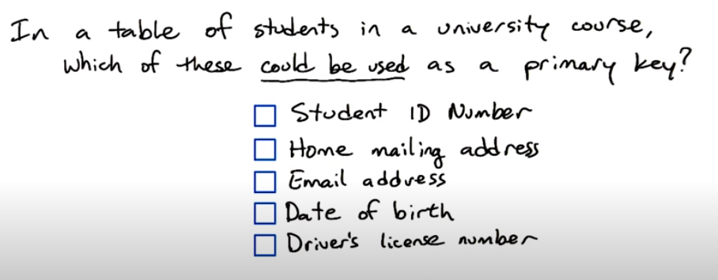
PRIMARY KEY
Notes:
Mailing address : sharing the same house
Email address : ok but maybe it is changed one day
DOB: maybe unique but a primary key has to be unique
Driver’s license No: some students don’t drive
‹#›

Slide 48
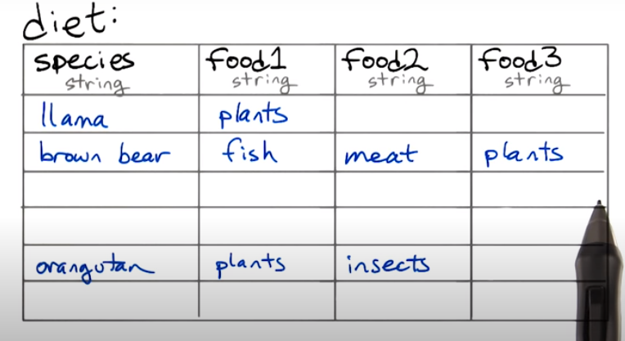
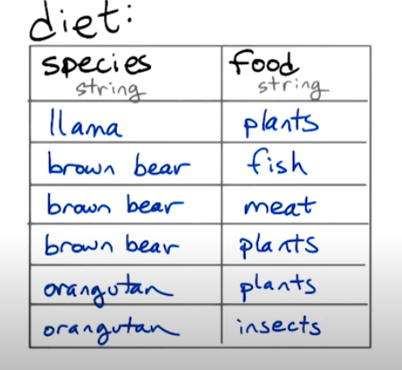
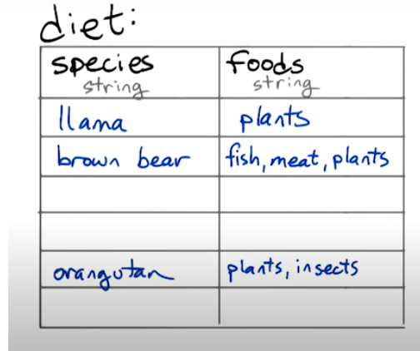
QUERIES
Notes:
The left table works better with joins, with aggregations and you don’t need to know the different types of food in advance.
In addition, no missing data
‹#›

Slide 49
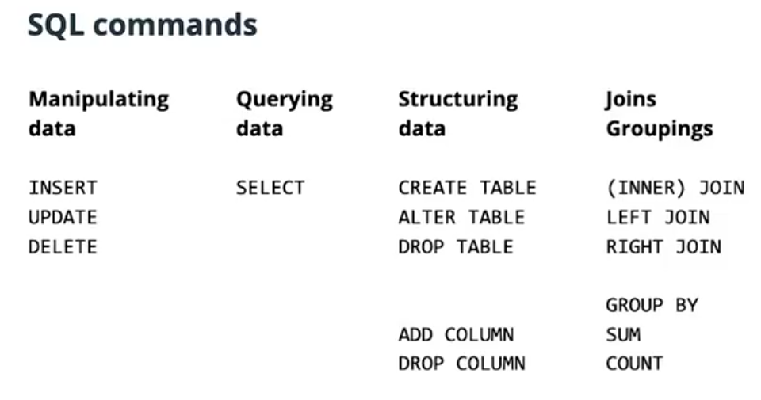
Notes:
PowerPoint Presentation
https://www.postgresqltutorial.com/wp-content/uploads/2018/03/PostgreSQL-Cheat-Sheet.pdf
‹#›

Slide 50
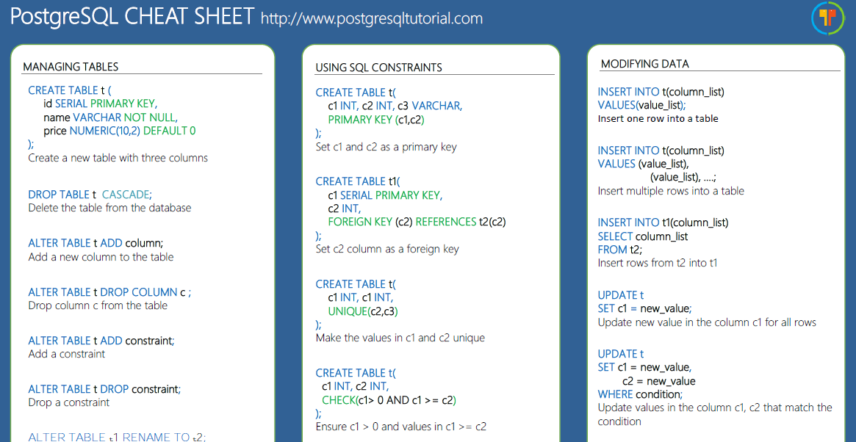
CHEAT SHEET
https://www.postgresqltutorial.com/postgresql-cheat-sheet/

Slide 51

FOFFA

Slide 52
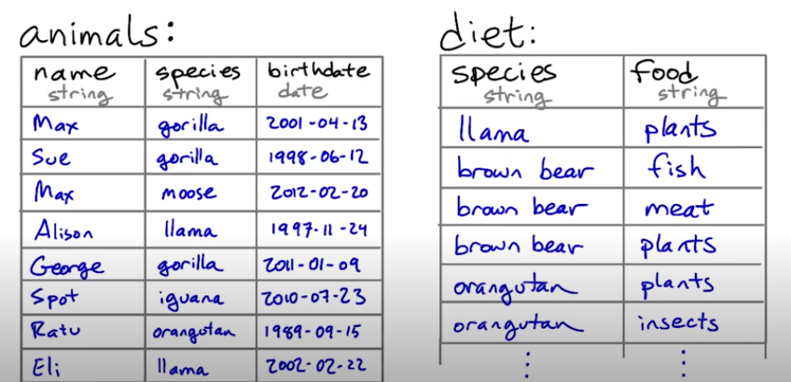
JOIN
Select animals that eat fish

Slide 53
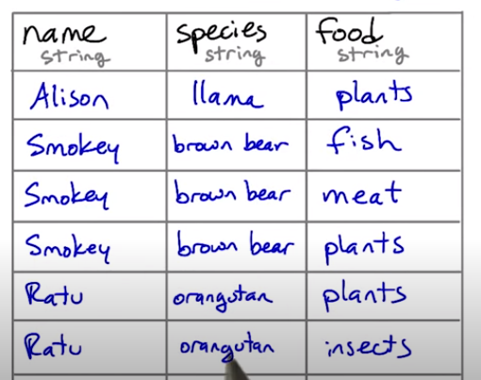
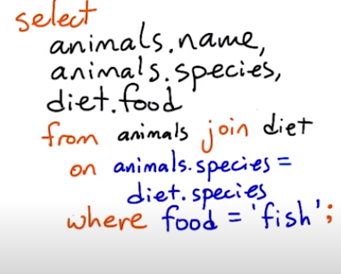
GENERATE THE NEW TABLE

Slide 54
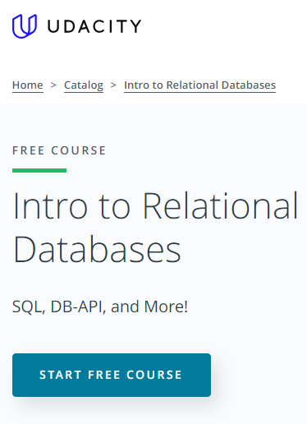
Notes:
[Intro to Relational database](https://www.udacity.com/course/intro-to-relational-databases--ud197)
‹#›

Slide 55
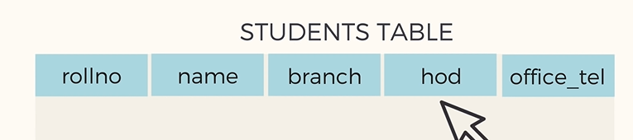
WHAT’S THE PROBLEM?
Notes:
Hod: head of department
‹#›

Slide 56
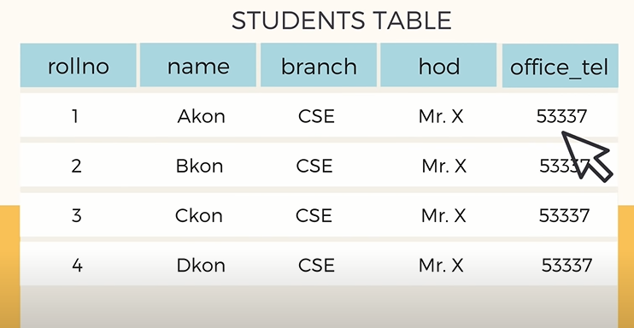
Apart from redundancy, are there any other problems?

Slide 57
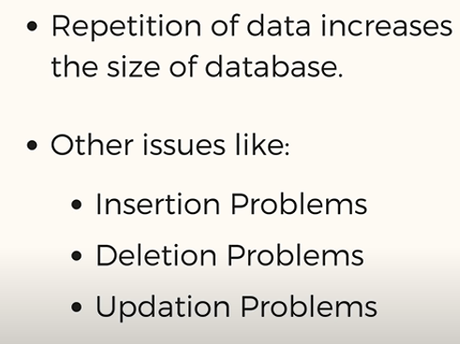
PROBLEM?
Apart from redundancy, are there any other problems?

Slide 58
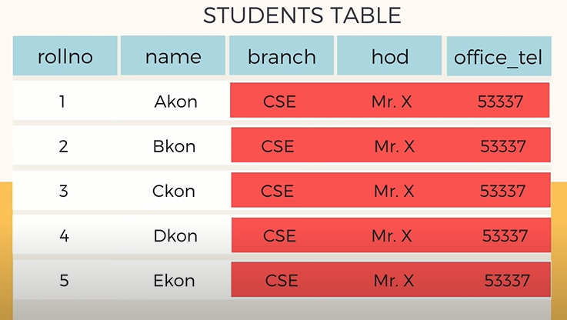


INSERTION ANOMALY
What if we want to add 100 students?
Notes:
‹#›

Slide 59
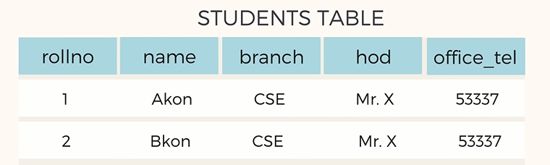
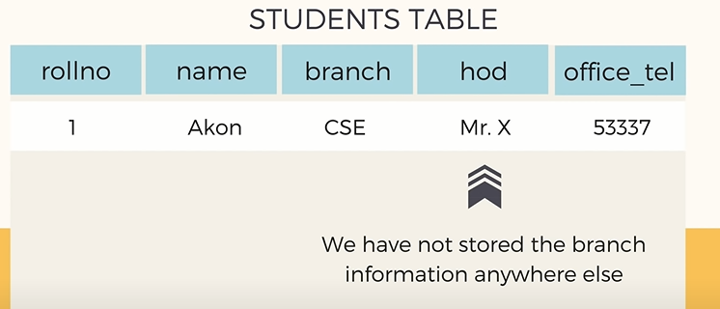

DELETION ANOMALY

Slide 60
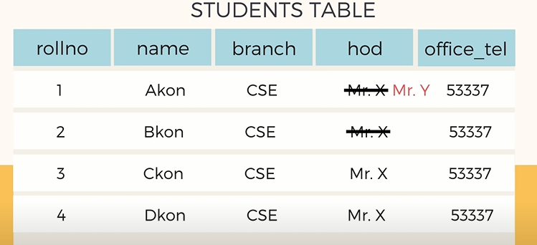
MODIFICATION ANOMALY

Slide 61
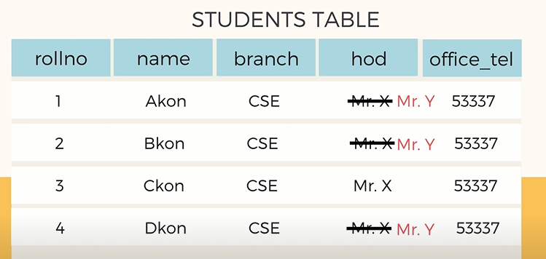
DO FOR ALL AND NEVER MISS
How to solve?
Notes:
If one is missed, there will be inconsistencies
‹#›

Slide 62

SOLUTION

Slide 63

ELIMINATE REDUNDANCY?
Notes:
One can say that there is still redundancy
Normalization is about minimizing redundancy not eliminating it.
‹#›

Slide 64

INSERT, UPDATE & DELETE NOW?
Notes:
Automatically updated for all students’ records
‹#›

Slide 65

DELETION SOLVED

Slide 66

MORE INFO
Notes:
Basic Concept of Database Normalization - Simple Explanation for Beginners - YouTube
https://www.youtube.com/watch?v=xoTyrdT9SZI
‹#›

Slide 67
RULES OF NORMALIZATION
unique primary key
Non-key relate to primary key
Non-key don’t relate to each others.
More rules ...

Slide 68



Export to database

Slide 69



Importing from a database

Slide 70

أفضل سيناريو

Slide 71

Data science?

Slide 72

DATA SCIENCE
Statistics
Data science
Exploratory data analysis
Data analytics
What and why?
Notes:
‹#›

Slide 73

DATA SCIENCE
Make data useful

Slide 74

العركة؟
What’s the difference?

Slide 75
ANALYTICS VS STATS VS ML?
Notes:
The SQL vs R vs Python taxonomy is ill-advised for so many reasons, not least of which is that software evolves. (As of recently, you can even do ML in SQL.) Wouldn’t you prefer a breakdown that’ll last?
by the algorithm (surprise! it’s how university courses are structured). Pretty please, don’t taxonomize by histograms vs t-tests vs neural networks. Frankly, if you’re clever and you have a point to make, you can use the same algorithm for any part of data science. It might look like Frankenstein’s monster, but I assure you it can be forced to do your bidding.
‹#›

Slide 76
Make data useful

Slide 77
العركة؟
What’s the difference?

Slide 78



ANALYTICS VS (STATISTICS/AI/ML/DP)

Slide 79

WHAT U SEE?

Slide 80


WHAT U SEE, AGAIN?
12 sec shake?
Notes:
Satellite photo of the “Face on Mars” which many people took as evidence of extraterrestrial habitation.
How to know if there is indeed life on Mars? Test
How to know if 12 sec shake of ink can give u a butterfly image?
Retry
‹#›

Slide 81



Slide 82
ANALYTICS VS (STATISTICS/AI/ML/DP)

Slide 83


Slide 84






DATA ANALYTICS
Notes:
The great news is that this one is easy. Think of your dataset as a bunch of negatives you found in a darkroom. Data-mining is about working the equipment to expose all the images as quickly as possible so you can see whether there’s anything inspiring on them. As with photos, remember not to take what you see too seriously. You didn’t take the photos, so you don’t know much about what’s off-screen. The golden rule of data-mining is: stick to what is here. Only make conclusions about what you can see, never about what you can’t see (for that you need statistics and lot more expertise).
‹#›

Slide 85

WANT MORE?
Notes:
What on earth is data science?. The quest for a useful definition | by Cassie Kozyrkov | HackerNoon.com | Medium
https://medium.com/hackernoon/what-on-earth-is-data-science-eb1237d8cb37
‹#›

Slide 86






Slide 87

DATA DRIVEN
Notes:
For a decision to be data-driven, it has to be the data — as opposed to something else entirely — that drive it. Seems so straightforward, and yet it’s so rare in practice because decision-makers lack a key psychological habit.
العربية الكارو محتاجة حمار عشان تبقى كارو
‹#›

Slide 88

SCENARIO
Notes:
Imagine that you are considering buying something online instead of making a pilgrimage to the other side of town to fetch it. You’ve boiled your decision down to whether or not you trust the online seller. A quick search yields some relevant data: you see that the seller has an average rating of 4.2 out of 5.
‹#›

Slide 89

WHAT U THINK?
Notes:
Now you can’t use that 4.2 to drive your decision. Game over! Once we’ve seen the answer, we’re free to pick the most convenient question. If the first thing we do is poke around in our data, our decision will be, at best, something I like to call data-inspired.
‹#›

Slide 90

DATA-DRIVENNESS DESTROYED
Any idea why?
Notes:
Once we’ve seen the answer, we’re free to pick the most convenient question
‹#›

Slide 91
DATA-DRIVENNESS DESTROYED
Once we’ve seen the
answer, we’re free to pick
the most convenient
question
Notes:
‹#›

Slide 92


Notes:
That’s where we, like whales encountering plankton, swim around in some numbers, and then reach an emotional tipping point and… decide. There are numbers near our decision somewhere, but those numbers don’t drive it. The decision comes from somewhere else entirely.
‹#›

Slide 93

Notes:
‹#›

Slide 94

Notes:
The decision-maker’s mind was made up before the data, so the decision was there all along. Turns out humans interact with data selectively to confirm choices we’ve already made in our heart of hearts. We find the most convenient light in which to see evidence, and we don’t always know we’re doing it. Psychologists have a lovely name for this: confirmation bias.
‹#›

Slide 95
IS IT GOOD?
Notes:
Positive
“It’s more than 4.0!”
They can even show a rigorous analysis about how it is statistically significantly higher than 4.0. (With certainty! It’s the p-value you’ve always wanted.)
Negative
“Why would I settle for a seller with less than 4.5 stars?” Or perhaps “But look at those 1-star reviews. I don’t like how many there are.” Sound familiar?
‹#›

Slide 96


Slide 97

SOLUTION
Notes:
Mathematical complexity doesn’t provide the antidote, it merely makes it harder to see the problem. As a result, what’s obvious in the trivial example we just saw becomes hidden in a jumble of gorgeous Gaussians. Don’t assume your friendly neighborhood data scientist sees it either. The more ways there are to slice the data, the more your analysis is a breeding ground for confirmation bias.
‹#›

Slide 98

But why?

Slide 99

Notes:
feel better about doing what they were going to do anyway.
‹#›

Slide 100


ANY PROBLEM WITH REAL PROJECTS?
Notes:
It’s all about rating
What about a real pro
‹#›

Slide 101



EXPENSIVE HOBBY

Slide 102

WHAT’S THE DECISION?
للأستاذة شيرين عبد الوهاب
Notes:
‹#›

Slide 103

Notes:
When decision-makers lack fundamental skills, there’s no math in the world that can fix it. Your data science team will not contribute to data-driven decision-making.
‹#›

Slide 104

WHAT IF?
Notes:
nothing would be different if all those poor data scientists just made some numbers up
‹#›

Slide 105


CASSIE ADVICE
Notes:
Data scientist friends, if your organization suffers from this kind of decision-maker, then I suggest sticking to the most lightweight and simple analyses to save time and money. Until the decision-makers are better trained, your showy mathematical jiu jitsu is producing nothing but dissipated heat.
‹#›

Slide 106


Slide 107

PROBLEM
How to solve?
Notes:
Problem: you’re free to move the goalposts after you find out where the data landed. (Of course you score a goal every time. You’re just that good.)
‹#›

Slide 108


SOLUTION
Notes:
set the goalposts in advance and resist temptation to move them later.
Framing the decision and setting decision criteria is a science of its own
a quick fix that goes a long way is to come up with your decision boundary up front in your data science project.
resis
‹#›

Slide 109

PRACTICE
How to set goal first?

Slide 110

SOLUTION
Notes:
she tugs at the pricetag on the back. “Hey, what does this say?” she asks me. “If it’s less than 80 bucks, I’ll buy it.”
‹#›

Slide 111

ORDER MATTERS
Notes:
Now that’s some decision intelligence! Instead of first seeing the price and then talking herself into a decision she’s already made, she uses the data to drive it. With a well-practiced reflex, she weighs how much she likes the dress and her budget, then sets the decision boundary, and only allows herself to see the data (price) once that’s done. She’s in the habit of using data in the right order and that’s a muscle you can exercise too.
‹#›

Slide 112

PRACTICE YOUR DATA DRIVEN MUSCLE
Notes:
People don’t always need to be data-driven and Emma knows that. She doesn’t have to make unimportant decisions that way, but she also knows that practice makes perfect. It’s much easier to build the habit on trivial decisions than to struggle when the important ones come around.
‹#›

Slide 113

NEGOTIATION 101
Notes:
I went to buy fireworks
I sticked to 80 pounds
‹#›

Slide 114

What if I didn’t ?

Slide 115

Notes:
In fact, standard advice for negotiators is to think through the entire range of potential offer combinations and plan your reactions to them in advance, otherwise it’s very easy for an experienced opponent to take advantage of you. Even without all the persuasion tactics at your counterpart’s disposal, irrelevant short-term factors like your blood sugar levels, your mood, how much the other party is smiling, and whether the sun is shining can have a disproportionate effect on the deal.
‹#›

Slide 116


APPLY FOR A JOB
Notes:
Next time you’re negotiating a salary, for example, make sure you’ve thought about your number before you hear theirs.
Whether you think about what a number means to you before or after you see it, you still have to think about it. Doing it beforehand helps you counter some of the bugs in your human programming, with large payoffs in decision quality and negotiation performance. Improving the order of operations here is a valuable habit to cultivate and crucial if you’d like to be involved in data-driven decision-making. And here’s some bonus good news: with practice it’ll feel automatic.
‹#›

Slide 117


Notes:
Data-Driven? Think again. The psychological habit most people… | by Cassie Kozyrkov | HackerNoon.com | Medium
https://medium.com/hackernoon/data-inspired-5c78db3999b2
‹#›

Slide 118

PANDAS
Axis
Minimally sufficient pandas
plotting

Slide 119

AXIS

Slide 120

Axis = 0
Axis = 1
Axis = ‘rows’
Axis = ‘index’
Axis = ‘columns’
Notes:
What do they mean?
‹#›

Slide 121

SERIES
Notes:
Python for Machine Learning: Pandas Axis Explained | Railsware Blog
https://railsware.com/blog/python-for-machine-learning-pandas-axis-explained/
Usually, in Python, one-dimensional structures are displayed as a row of values. On the contrary, here we see that Series is displayed as a column of values.
‹#›

Slide 122

DATAFRAME
Notes:
Our DataFrame object has 0, 1, 2, 3, 4 indexes along the “axis 0”, and additionally, it has “axis 1” indexes which are: ‘a’ and ‘b’.
‹#›

Slide 123

WHAT’S THE OUTPUT?

Slide 124

NO DIFFERENCE [SINGLE AXIS]

Slide 125


WHAT’S THE OUTPUT?

Slide 126


SOLUTION
Notes:
We see, that having sum with axis=0 smashed all values along the direction of the “axis 0” and left only columns(‘a’ and ‘b’) with appropriate sums.
‹#›

Slide 127

OTHER SOLUTION
Notes:
If you prefer regular names instead of numbers, each axis has a string alias. “axis 0” has two aliases: ‘index’ and ‘rows’. “axis 1” has only one: ‘columns’. You can use these aliases instead of numbers:
‹#›

Slide 128


DROPPING NAN VALUES
What to expect?
Notes:
‹#›

Slide 129


SOLUTION
Notes:
Now .dropna collapsed “axis 1” and removed all columns with NaN values. Columns ‘a’ and ‘b’ contained NaN values, thus only ‘c’ column was left.
‹#›

Slide 130



CONCATENATION
Output?

Slide 131


CONCATENATION
Notes:
Pandas borrowed the “axis” concept from NumPy library. The “axis” parameter does not have any influence on a Series object because it has only one axis
‹#›

Slide 132


SETTING THE SCENE
Notes:
d represents the weighted average of 50 Indian company stocks in 17 sectors. The dataset is openly available on Kaggle, but we’ll be using a subset of the data containing the stock value of only four sectors – banking, pharma, IT, and FMCG.
‹#›

Slide 133



WHAT TO EXPECT?
Notes:
Where is the x?
‹#›

Slide 135

SOLUTION
Notes:
Where is the x?
You will also need to specify the x and y coordinates to be referenced as the x and y-axis. Since the Date is already the index column, it will be configured as the X-axis.
‹#›

Slide 136

OTHER OPTIONS?
https://pandas.pydata.org/pandas-docs/stable/reference/api/pandas.DataFrame.plot.html

Slide 137


Slide 138

BAR PLOTS
Can we use a bar plot?

Slide 139

SOLUTION: GROUP/AGGREGATE
Can we draw bar charts for all 4 columns?
Notes:
data.resample() is used to resample the stock data.
The ‘M’ stands for month-end frequency and denotes the offset values you want to resample the data.
mean() indicates the average stock price during this period.
Is the average per month or the last day only?
‹#›

Slide 140

How to convert to bar.. Multiple bars?
Notes:
‹#›

Slide 141

SOLUTION
Notes:
‹#›

Slide 142

SIMILAR SOLUTION
Notes:
‹#›

Slide 143

HOW TO GET THIS?

Slide 144

SOLUTION

Slide 145


STACKED?

Slide 146

WHAT ABOUT HORIZONTAL STACKED?

Slide 147
CORRECT ☺

Slide 148

HISTOGRAMS VS BAR PLOTS?
Any differences?
Notes:
‹#›

Slide 149

Axes needed?
Sure for bar graph?
Notes:
1 for hist
2 for bar
What about count plot?
‹#›

Slide 150


COUNTPLOT
http://seaborn.pydata.org/examples/index.html
Also check their tutorial tab
Notes:
‹#›

Slide 151

HISTOGRAM OR BAR PLOT?

Slide 152
HISTOGRAM OR BAR PLOT?
What does the code mean?
Notes:
The default bin value is 10. Bin size can be changed using the “bins” keyword.
Alpha sets the transparence
We selected only two columns
‹#›

Slide 153

WHAT TO CHOOSE?

Slide 154
WHAT TO CHOOSE?
Notes:
‹#›

Slide 155

OTHER OPTIONS
Notes:
A hexagonal bin plot, also known as a hexbin plot, can be used as an alternative to scatterplots. This kind of plot is particularly useful when the number of data points is huge, and each point cannot be plotted individually.
‹#›

Slide 156

https://neptune.ai/blog/pandas-plot-deep-dive-into-plotting-directly-with-pandas?utm_source=datacamp&utm_medium=post&utm_campaign=blog-pandas-plot-deep-dive-into-plotting-directly-with-pandas
Notes:
Pandas objects come equipped with their plotting functions. These plotting functions are essentially wrappers around the matplotlib library. Think of matplotlib as a backend for pandas plots.
5 Minute Guide to Plotting with Pandas | by Rebecca Vickery | Towards Data Science
https://towardsdatascience.com/5-minute-guide-to-plotting-with-pandas-e8c0f40a1df4
Fast plotting with Pandas. Quickly visualize your data with these… | by Tom Waterman | Towards Data Science
https://towardsdatascience.com/the-best-pandas-plotting-features-c9789e04a5a0
Data Visualization with Pandas and Seaborn 🎓 | by Tirendaz Academy | Level Up Coding
https://levelup.gitconnected.com/data-visualization-with-pandas-and-seaborn-5de444b567a0
08.Pandas Visualization | jupyter notebooks gallery
https://notebook.community/vravishankar/Jupyter-Books/pandas/08.Pandas%20Visualization
Python for Librarians: Plotting Your Data - Pandas
https://librarycarpentry.org/library-python/06a-plotting-with-pandas/
5.0
https://phdphysics.cloud.ba.infn.it/wp-content/uploads/2017/06/8-Diacono-3Maggio.pdf
Univariate plots in pandas | Python
https://campus.datacamp.com/courses/python-for-r-users/plotting-4?ex=2
Pandas Foundations | DataCamp
https://learn.datacamp.com/courses/pandas-foundations?tap_a=5644-dce66f&tap_s=93618-a68c98
Data Science Courses: R & Python Analysis Tutorials | DataCamp
https://learn.datacamp.com/search?q=pandas+plot
Pandas Plot: Deep Dive Into Plotting Directly with Pandas - neptune.ai
https://neptune.ai/blog/pandas-plot-deep-dive-into-plotting-directly-with-pandas?utm_source=datacamp&utm_medium=post&utm_campaign=blog-pandas-plot-deep-dive-into-plotting-directly-with-pandas
‹#›

Slide 157

WHERE TO FIND REAL DATA?
Notes:
Popular open data repositories
UC Irvine Machine Learning Repository
Kaggle datasets
Amazon’s AWS datasets
Meta portals (they list open data repositories)
Data Portals
OpenDataMonitor
Quandl
Other pages listing many popular open data repositories
Wikipedia’s list of Machine Learning datasets
Quora.com
The datasets subreddit
‹#›

Slide 158
REAL DATA RESOURCES
Popular open data repositories
UC Irvine Machine Learning Repository
Kaggle datasets
Amazon’s AWS datasets
Meta portals (they list open data repositories)
Data Portals
OpenDataMonitor
Quandl
Other pages listing many popular open data repositories
Wikipedia’s list of Machine Learning datasets
Quora.com
The datasets subreddit

Slide 159


FREQUENT ERROR

Slide 160
HOW TO USE CONDA FROM THE JUPYTER NOTEBOOK
# DON'T DO THIS!
!conda install --yes numpy
import sys
!conda install --yes --prefix {sys.prefix} numpy
Notes:
Use the second option
That bit of extra boiler-plate makes certain that conda installs the package in the currently-running Jupyter kernel
Installing Python Packages from a Jupyter Notebook | Pythonic Perambulations
https://jakevdp.github.io/blog/2017/12/05/installing-python-packages-from-jupyter/
‹#›

Slide 161
HOW TO USE PIP FROM THE JUPYTER NOTEBOOK¶
# DON'T DO THIS
!pip install numpy
import sys
!{sys.executable} -m pip install numpy
Notes:
That bit of extra boiler-plate makes certain that you are running the pip version associated with the current Python kernel, so that the installed packages can be used in the current notebook. This is related to the fact that, even setting Jupyter notebooks aside, it's better to install packages using
$ python -m pip install <package>
rather than
$ pip install <package>
because the former is more explicit about where the package will be installed (more on this below).
‹#›

Slide 162

Project 1 walkthrough

Slide 163



https://codebeautify.org/sqlformatter

Slide 164

https://review.udacity.com/#!/rubrics/3337/view

Slide 165
SQL resources
https://www.codingninjas.com/codestudio/problem-lists/top-100-sql-problems
https://geekflare.com/sql-practice-platforms/
https://learnsql.com/blog/sql-basics-cheat-sheet/sql-basics-cheat-sheet-letter.pdf
Notes:
https://geekflare.com/sql-practice-platforms/
https://www.codingninjas.com/codestudio/problem-lists/top-100-sql-problems
https://learnsql.com/blog/sql-basics-cheat-sheet/sql-basics-cheat-sheet-letter.pdf

Slide 166
BREAKOUT ROOM
Introduction to projects
https://app.datacamp.com/learn/projects/introduction-to-projects
What and Where Are the World's Oldest Businesses?
https://projects.datacamp.com/projects/1168

